Slide 1
Lecture 1.2 – Introduction
Data - meaningful facts about an object, person etc.
Data communication – exchange of data between
two devices via some forms of transmission medium
such as wire cable.
Communication system – made up of a combination
of hardware (physical equipments) and software
(programs).

Slide 2
Effectiveness of Data Communication
The effectiveness of communication system three fundamental
characteristics:
Delivery – the system must deliver the data to the correct destination. Data must be received by the intended device or user.
Accuracy – the system must deliver the data accurately. Data that have been altered in transmission and left uncorrected are unusable.
Timeliness – the system must deliver the data in timely manner. Data delivered in late are useless.

Slide 3
Components of Data Communication
There are five components of data communication:
Message – the information to be communicated. It can consist of text, numbers, pictures, sound, or video-or combination of these.
Sender – the device that sends the data message. Example - computer, workstation, telephone handset, video camera, and so on.
Receiver – the device that receives the message. Example- computer, workstation, telephone handset, television, and so on.
Medium – the physical path by which a message travels from sender to receiver. Example – twisted-pair, coaxial cable, fiber optics, or radio waves (terrestrial or satellite microwave).
Protocol – a set of rules that governs the data communication. It represents an agreement between the communicating devices. Without protocol, two devices may be connected but not communicating. Ex – a person speaking in Bangla can be understood by a French speaking person with set of rules like translation process.

Slide 4
Components of Data Communication
Protocol
Step 1:
Step 2:
Step 3:
……..
……..
Protocol
Step 1:
Step 2:
Step 3:
……..
……..
Sender
Message & Medium
Receiver

Slide 5
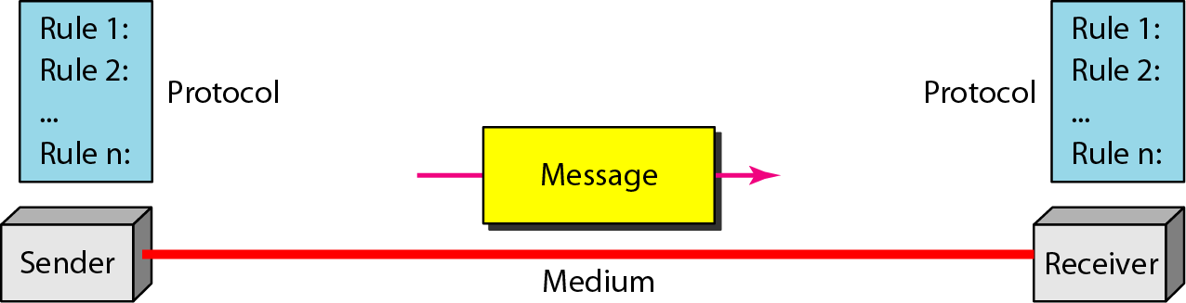
Alternate Figure: Components of a data communication system

Slide 6
Direction of Data Flow
Communication between two devices can be:
Simplex – signals are transmitted in one direction; only one of the devices on a link can transmit while the other one only receive. Example – Keyboard and traditional monitor.
Half-Duplex – Both way data transmission but one at a time. Examples – Walkie-talkies, Citizens Band radios.
Full-Duplex – Both can transmit data simultaneously. Example – Telephone.

Slide 7
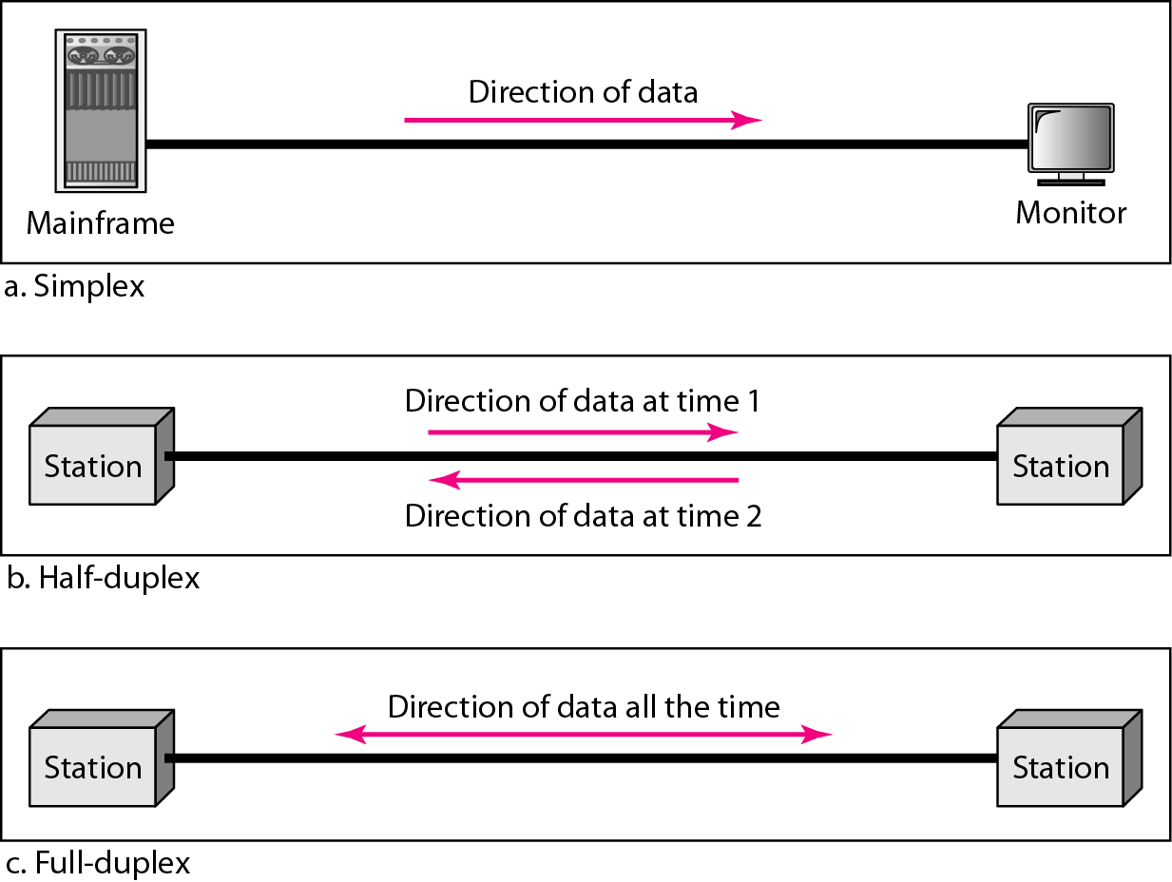
Data flow (simplex, half-duplex, and full-duplex)

Slide 8
NETWORK
A network is a set of devices (often referred to as nodes) connected by
communication links. A node can be a computer, printer, or any other device
capable of sending and/or receiving data generated by other nodes on the
network.
Distribute Processing:
A network must meet the following criteria:
Performance – can be measured in many ways, including transmit time and response time. The performance of a network depends on a number of users, the type of transmission medium, capabilities of the connected hardware, and the efficiency of the software.
Reliability – is measured by the frequency of failure, the time it takes a link to recover from a failure, and the network robustness in a catastrophe.
Security – measure by the capabilities of protecting data from unauthorized access.

Slide 9
Network Connections
There are two types of connection:
Point-to-point – provides a direct link between two devices. The entire capacity is reserved for transmission between those two devices.
Multipoint – more than two devices share a single link. Example – Bus Topology.

Slide 10
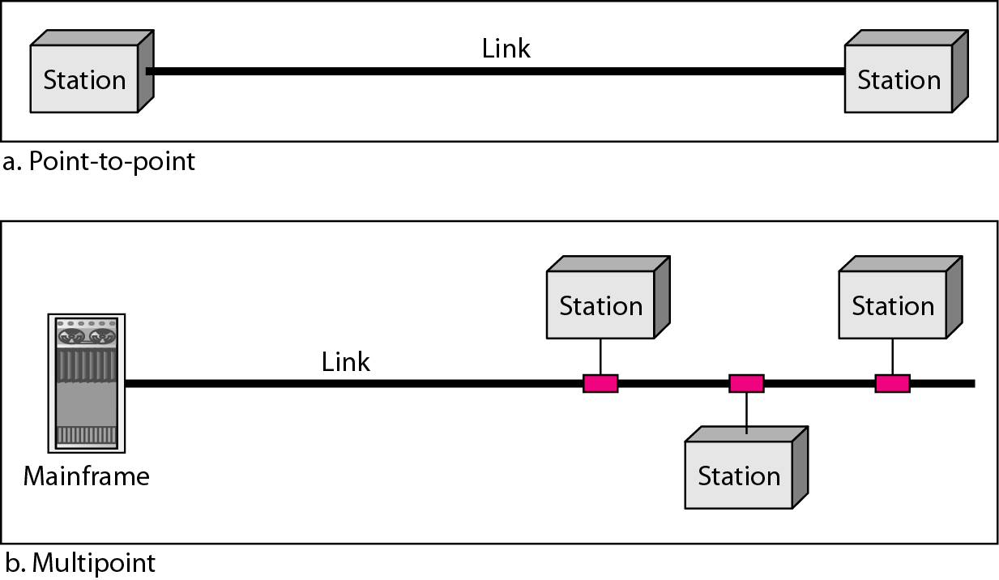
Types of connections: point-to-point and multipoint

Slide 11
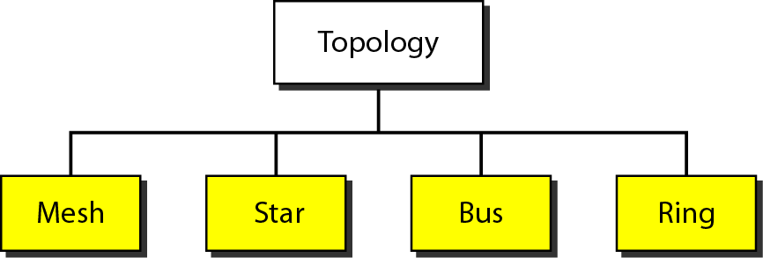
Network Topology
Topology refers to the way a network is laid out physically.
There are four basic types of topologies:

Slide 12
Topology Mesh Topology
Every device has a dedicated point-to-point link to every other device. A fully connected mesh network has n(n-1)/2 physical channels to link n devices.
Advantages:
No data traffic problems.
Robust networking system
Privacy and security
Disadvantages.
Amount of cabling
Number of I/O ports
Installation and connection
More cable space
Expensive I/O ports and cables

Slide 13
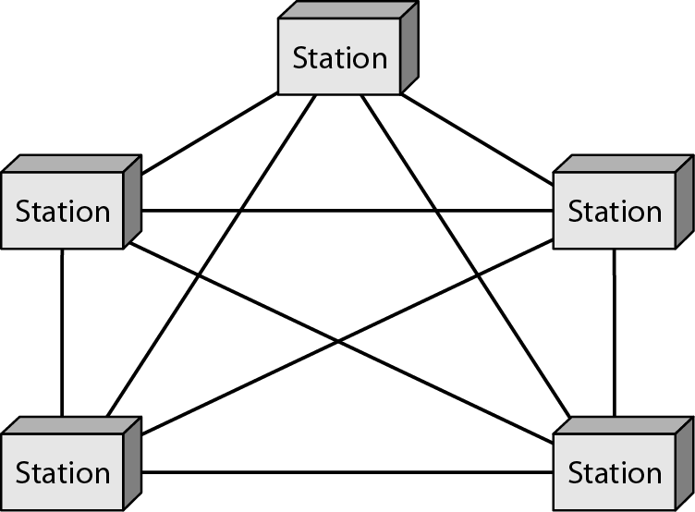
A fully connected mesh topology (five devices)

Slide 14
Topology Continues..
Star Topology – in a star topology, each device has a
dedicated point-to-point link only to a central controller
called hub; hub relays the data to receiver that came from
sender.
Advantages:
Less expensive than Mesh topology
Easy to install and configure
Robust networking system
Easy fault identification and fault isolation
Disadvantages.
Amount of cabling
Each node must be linked to the central hub

Slide 15
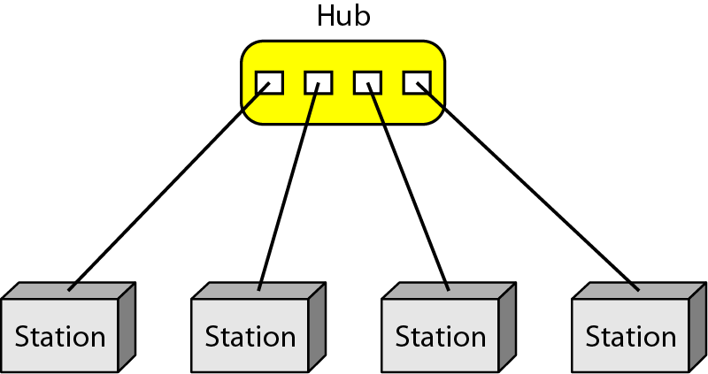
A star topology connecting four stations

Slide 16
Topology Continues..
Bus Topology – a multipoint topology where a long cable
acts as a backbone to link all the devices in a network.
Nodes are connected to the bus by drop lines and taps.
Advantages:
Easy to install and configure
Less cabling than Mesh or Star
Disadvantages.
Difficult to reconnect
Difficult to isolate a fault
Difficult to connect new device to the backbone
A fault or broken backbone can stop the network connection

Slide 17
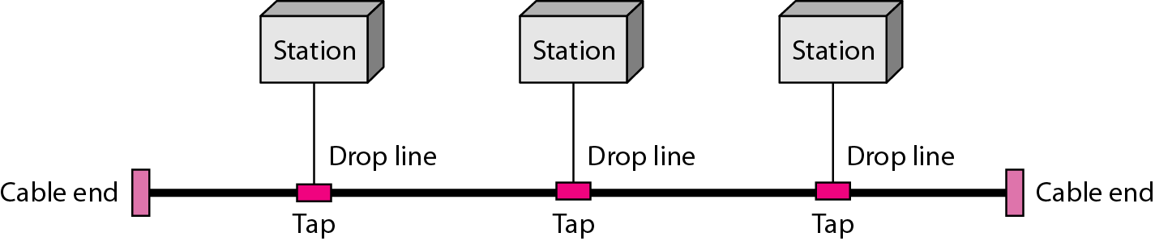
A bus topology connecting three stations

Slide 18
Topology Continues..
Ring Topology – each device has a dedicated point-to-point connection only with the two devices on either side of it. A signal is passed along the ring in one direction, from device to device, until it reaches its reaches its destination. Generally in a ring, a signal is circulating at all times. If a device does not receive a signal in a specified period, it can issue an alarm.
Advantages:
Easy to install and configure
Less cabling than Mesh or Star
Disadvantages.
Limited number of devices
Limited length in connecting medias
Unidirectional traffic
A break in the ring can stop the entire network

Slide 19
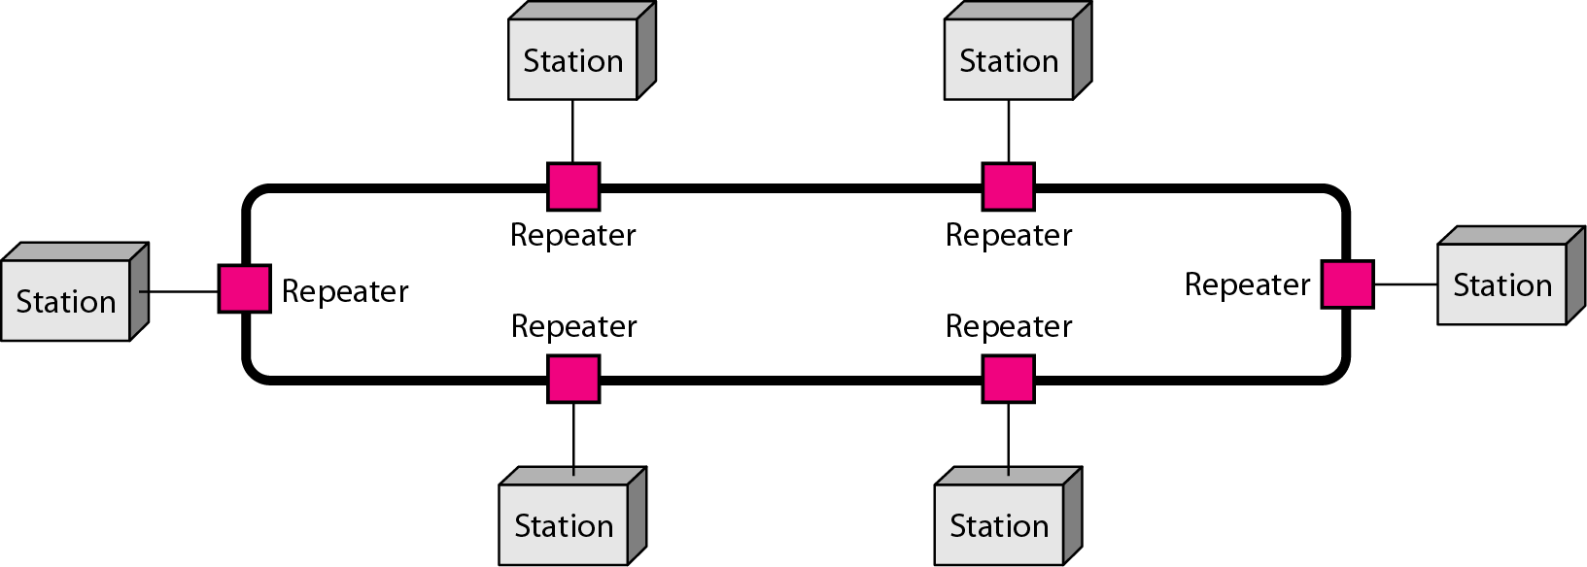
A ring topology connecting six stations

Slide 20
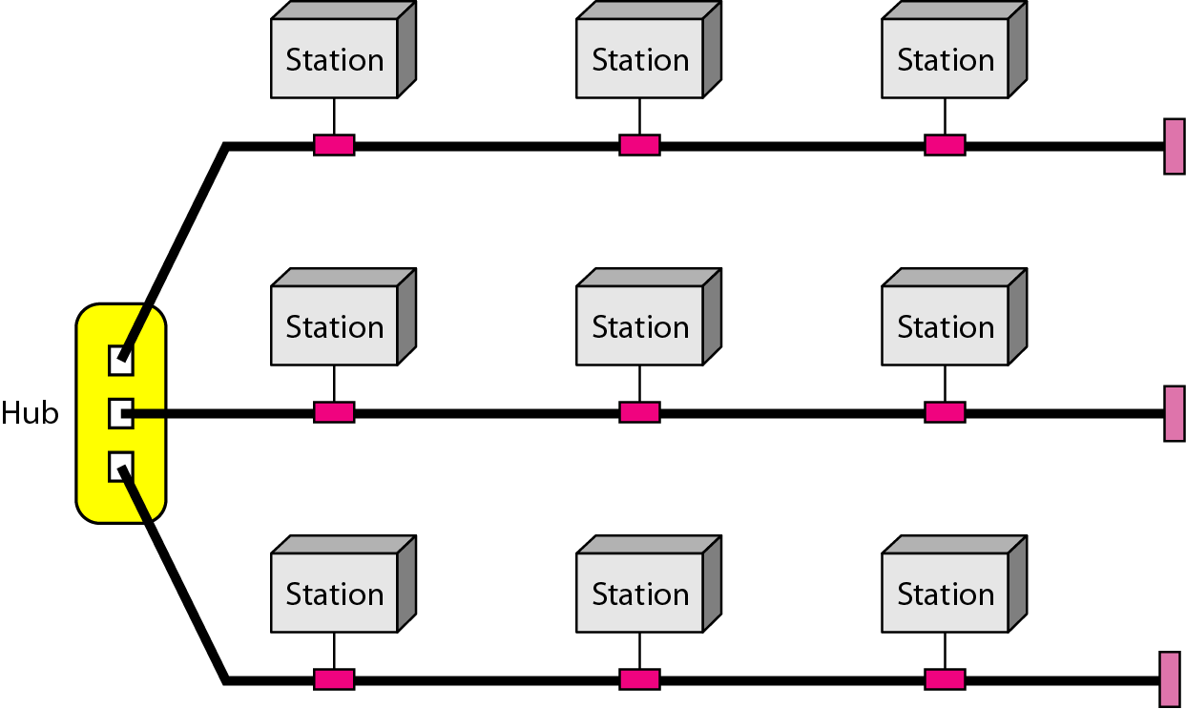
A hybrid topology: a star backbone with three bus networks

Slide 21
How do we decide which topology to use?
Depends on the following factors.
Reliability
Expandability/Flexibility
Performance

Slide 22
Categories of Networks
When we speak of networks, we generally refer to
three primary categories.
LAN – Local Area Network
MAN – Metropolitan-area network
WAN – Wide Area Network

Slide 23
LAN
Usually privately owned and links the devices in a single office, building, or campus.
Short distances
Designed to provide local interconnectivity
LAN size is limited to a few kilometers.
Designed to allow resources to be shared between personal computers.
LAN are distinguished from other types of networks by their transmission media and topology.
LAN have data rate in the 4 to 6 Mbps.

Slide 24
MAN
Designed to extend over an entire city.
MAN to connect several LANs in the entire city
Provide connectivity over areas such as a city, a campus
Example – Cable television network

Slide 25
WAN
Provides long distance transmission of data, voice, image, and video information over large geographic areas that may comprise a country, a continent, or even the whole world.
Long distances
Provide connectivity over large areas
Enterprise Network – WAN that is wholly owned and used by a single company is often referred to as enterprise network.

Slide 26
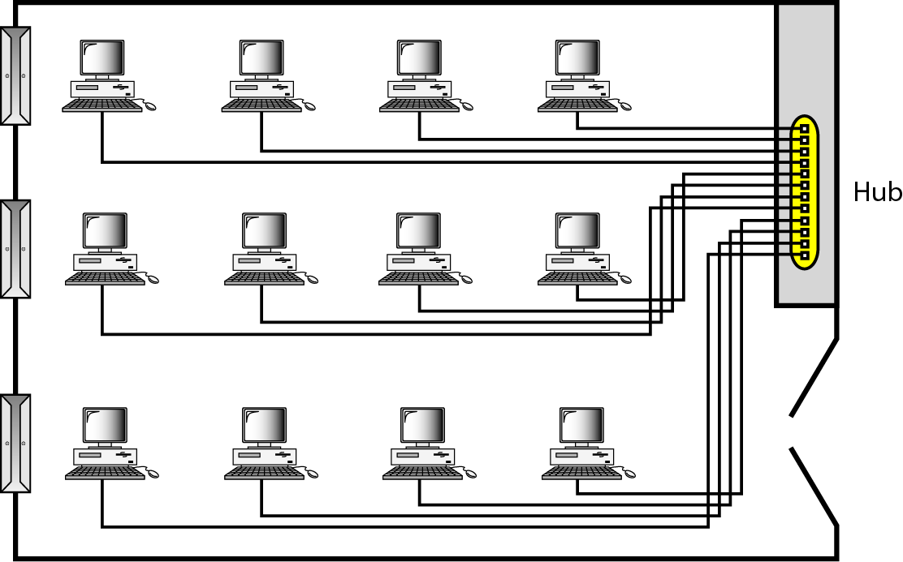
An isolated LAN connecting 12 computers to a hub in a closet

Slide 27
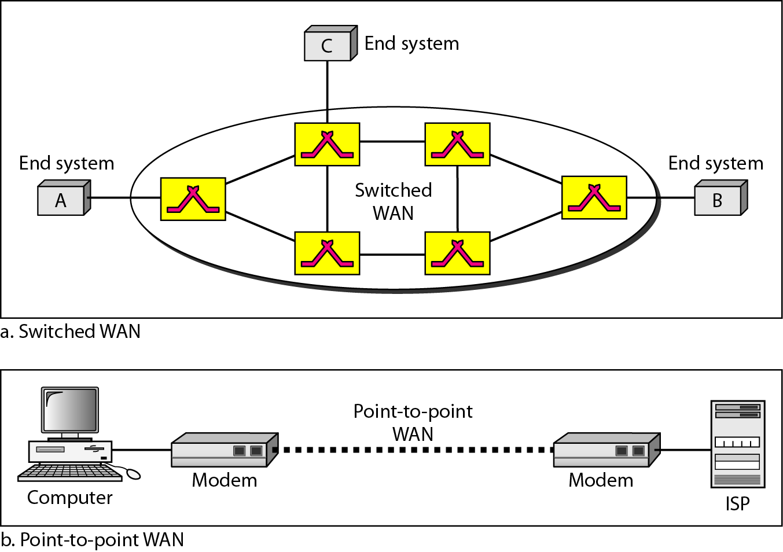
WANs: a switched WAN and a point-to-point WAN

Slide 28
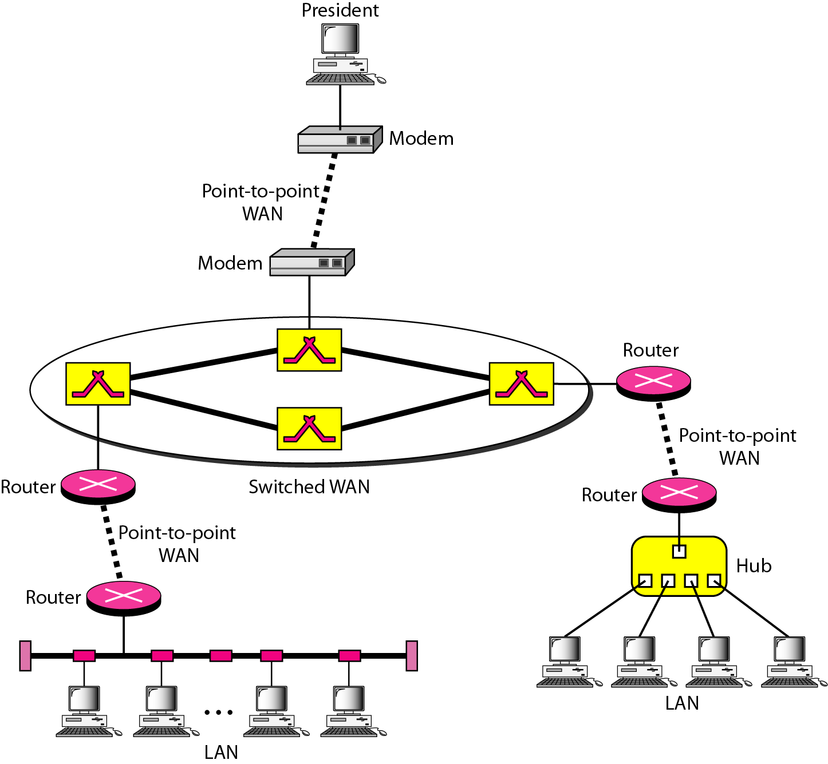
A heterogeneous network made of four WANs and two LANs

Slide 29
Internet
Collection of more than hundreds of thousands many separate networks.
Began its journey in 1969 as ARPANET.
TCP/IP protocol is used for internetworking
IP (Internet Protocol) is used for datagram routing; TCP (Transmission Control Protocol) is used for higher level of internetworking functions such as segmenting, reassembly, and error detection.
Internet connections are provided through local ISPs.

Slide 30
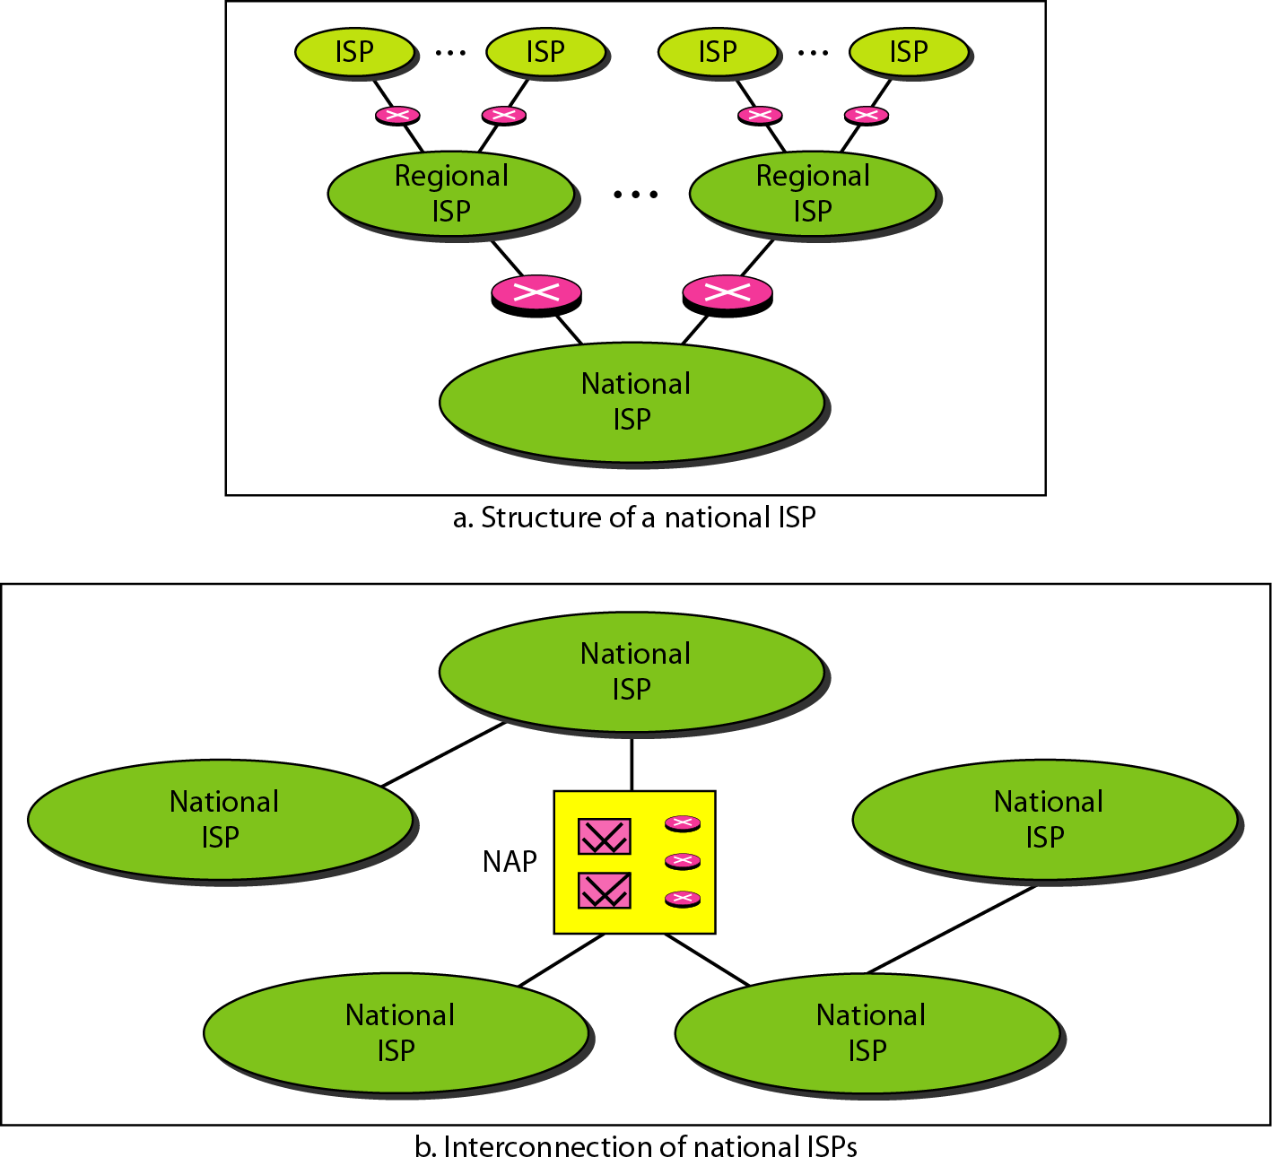
Hierarchical organization of the Internet
NAP = Network Access Point

Slide 31
Protocol
A set of rules that govern data communications.
A protocol defines-
how what is communicated
how it is communicated
when it is communicated
The key elements of protocols are –
Syntax
Semantics
Timing

Slide 32
Key Elements of a Protocol
Syntax
Structure or format of the data
Indicates how to read the bits - field delineation
Example – of a particular packet, first 8 bit is the address of the sender, the second 8 bit is the address of the receiver, and the rest is the message itself.
Semantics
Interprets the meaning of the bits
Knows which fields define what action
Example – does the address identify the route to be taken or the final destination to the message?
Timing
When data should be sent and what
Speed at which data should be sent or speed at which it is being received.

Slide 33
Thank You

